Slide 1
Chapter 3
Physical Layer
(OSI Model)
Module 4: Physical Layer
Introduction to Networks v7.0 (ITN)

Slide 2
Objectives
3.1 Physical Layer Protocols
3.2 Network Media

Slide 3
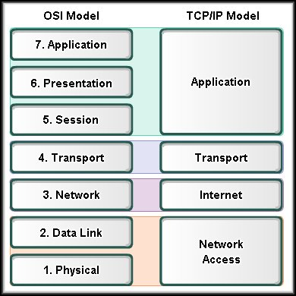
3.1 Physical Layer Protocols

Slide 4

Cont’d…
Before any communication can take place, a
connection to a local network must be established
The connection can be in the form of wired (cable) or wireless (radio waves)

Slide 5
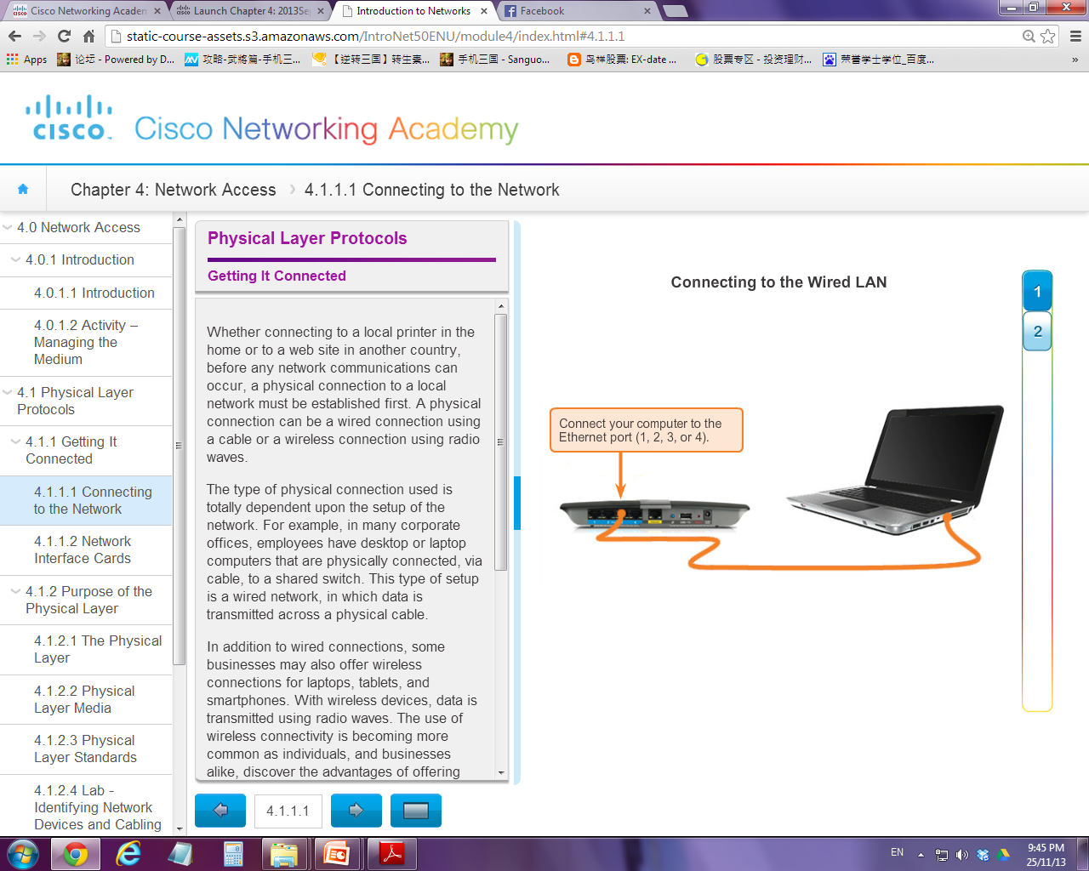
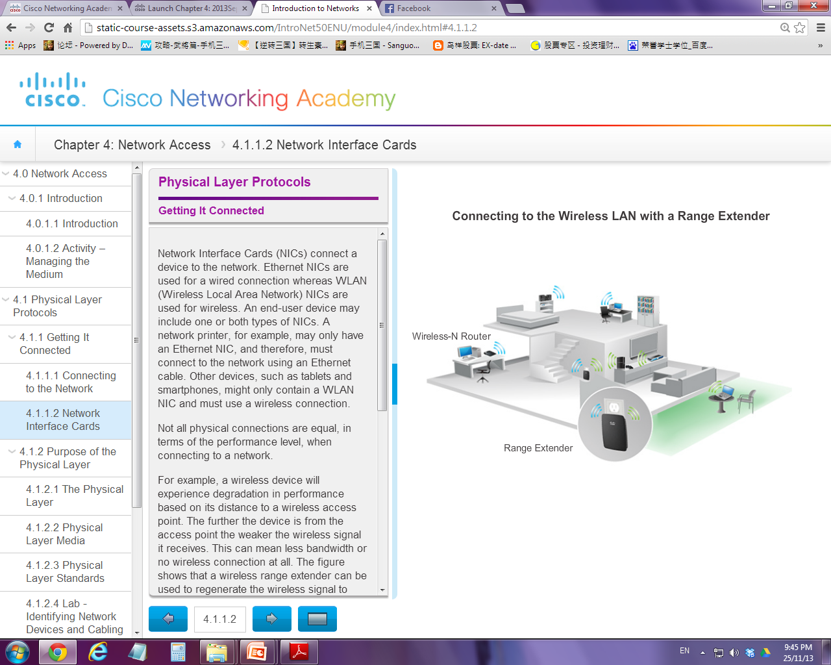

Slide 6
Basic Terms
Transmission media / medium
Means that are used to carry signal from one location to another
Bit stream
Computer data which is presented in a sequence of bits
Encoding
To format / represent bit stream into a specific predictable / recognisable pattern before placing onto media
Signalling
To convert the encoded bits stream in different signal forms
Generate signals in different forms according to the media used (eg. electrical, light pulses or waves)

Slide 7
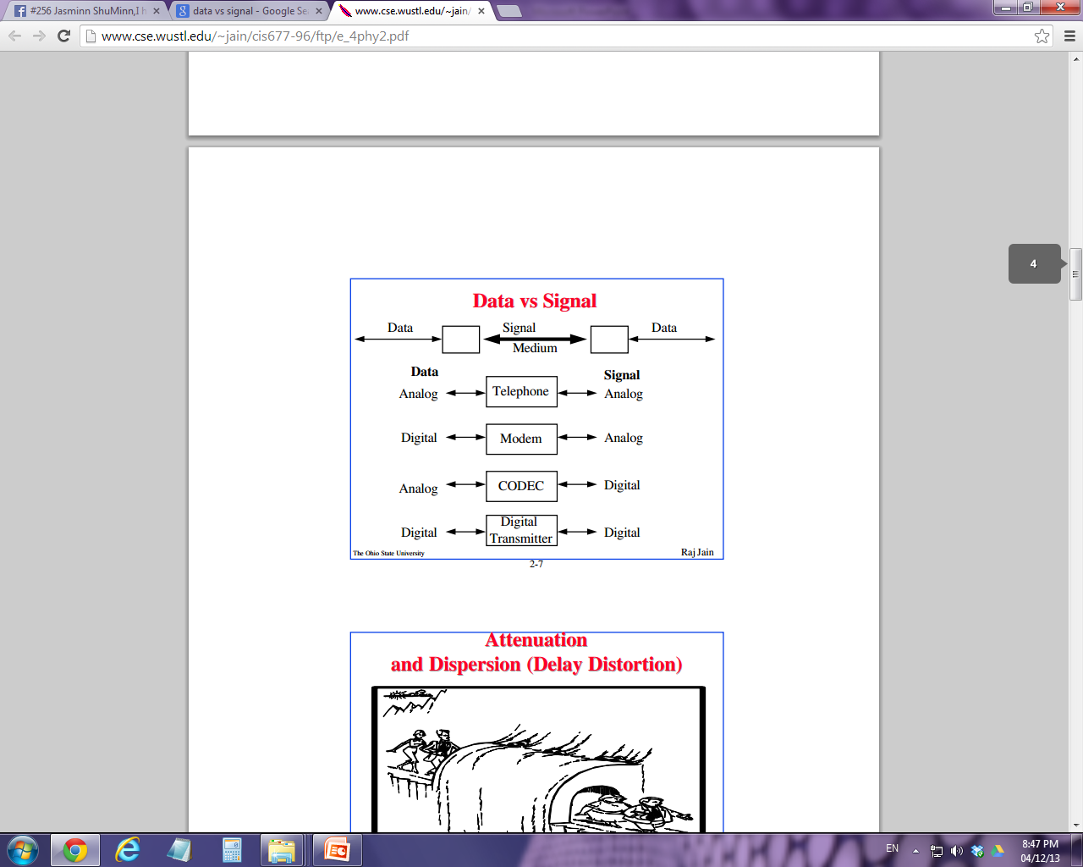
Sender side
Transmission
media
Receiver side

Slide 8
3.1.1 Roles of Physical Layer
The OSI Physical layer provides the means to transport the frame across the network
Physical Layer accepts frame from Data Link Layer, encodes the frame and creates the electrical, optical, or radio wave signals (signalling) that represent the bits in each frame.
(include h/w, media and connector specifications)
1
2
3

Slide 9
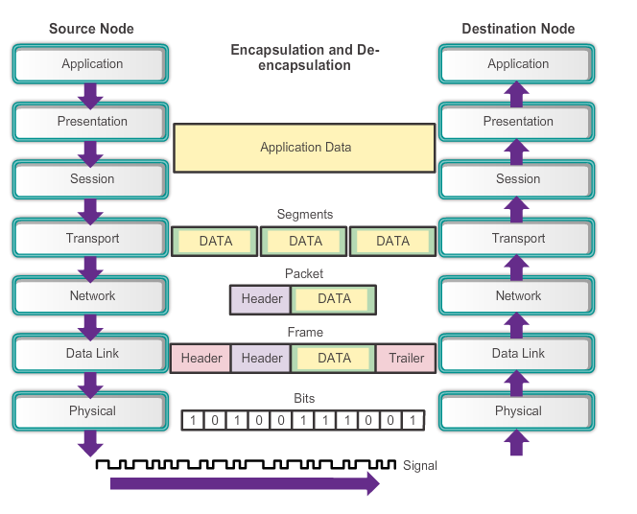
Full Picture of Encapsulation / De-encapsulation
Encode and create signals that represent the frame bits
Retrieve the signals and restore them into frame bits

Slide 10
Cont’d…
There are three basic forms of network media.
Copper cable: The signals are patterns of electrical pulses.
Fiber-optic cable: The signals are patterns of light.
Wireless: The signals are patterns of microwave transmissions.

Slide 11
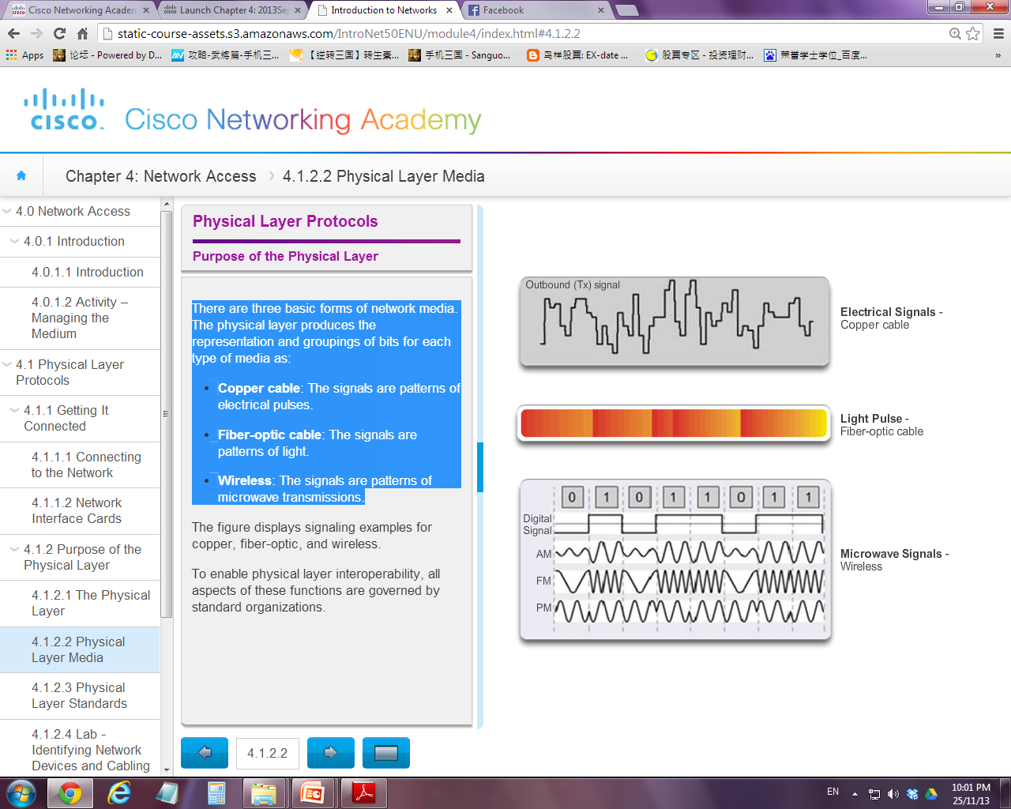

Slide 12
3.1.2 Physical Layer Standards (Protocols)
To ensure interoperability, all aspects of Physical Layer are governed by the standard organizations:
International Organization for Standardization (ISO)
Telecommunications Industry Association / Electronic Industries Association (TIA / EIA)
International Telecommunication Union (ITU)
American National Standards Institute (ANSI)
Institute of Electrical and Electronics Engineers (IEEE)

Slide 13


Slide 14
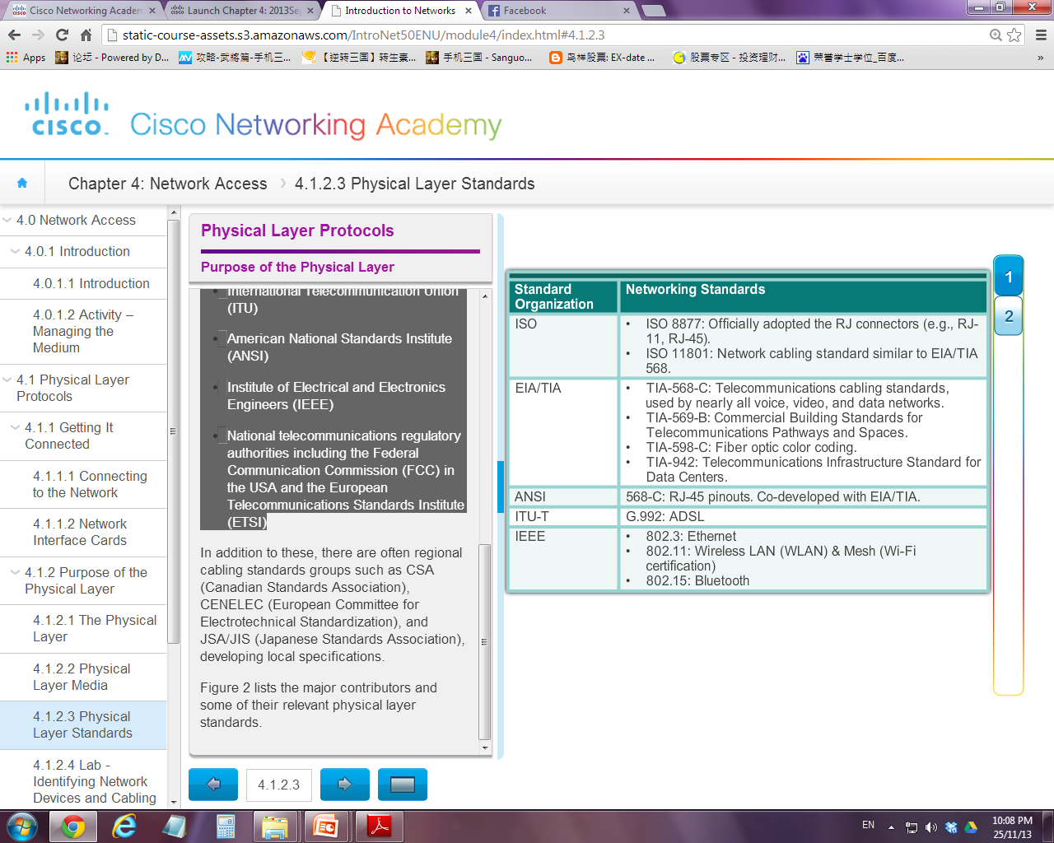
Physical Layer Standards

Slide 15
3.1.3 Fundamental Principles of Layer 1
The physical layer standards emphasize on the following three functional areas:
Physical media standards
Encoding standards
Signalling standards

Slide 16
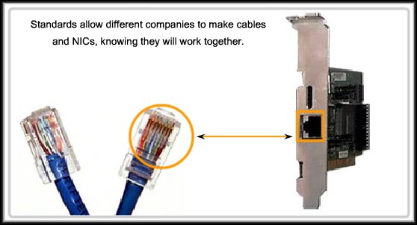
Physical Component Standards
Concern about electronic hardware devices, media, and other connectors that are used to transmit and carry the signals, eg. ISO 8877
Hardware design
Interfaces and connectors design
Cable materials
Cable design

Slide 17
Encoding standards
Concern about converting a stream of data bits into a predefined patterns.
The “patterns” are grouping of bits that can be recognized by both sender and receiver
Eg.
what pattern represents start-of-frame
what pattern represents end-of-frame
What pattern represent valid data bits
What pattern represent invalid data bits

Slide 18
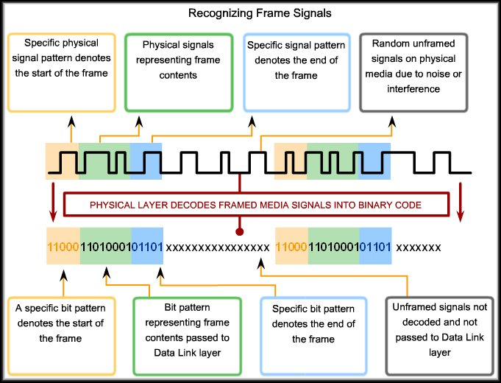

Slide 19
Signaling standards
Concern about generating the signal in the forms of electrical, optical, or wireless depending on media used

Slide 20
Data Carrying Capacity
Different media support different transfer speeds
Data transfer is usually measured using:
Bandwidth
Throughput
Goodput

Slide 21

Bandwidth
Bandwidth is referring to the amount of data that can be transmitted in a given duration
Usually measured in kilobits per second (kbps) or megabits per second (Mbps)
Theoretical (Ideal) transmission rate

Slide 22
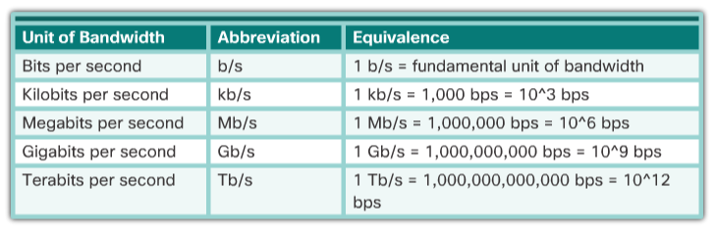

Slide 23
Throughput
Throughput is the measure of the actual amount of data transmitted over a given period of time
Practical transmission rate / actual network performance
Due to a number of factors (eg. traffic and latency), throughput usually does not match the specified bandwidth

Slide 24
Goodput
It is the measure of usable data transferred over a given period of time
Most interest to network users
Quality of transmission
Goodput = Throughput – traffic overhead
*Overhead in establishing session, encapsulation, acknowledgement

Slide 25
3.2 Network Media
Transmission media
Copper Media
Fiber Media
Wireless Media
Twisted Pair Cable
Coaxial Cable
UTP
STP
Types of Media

Slide 26
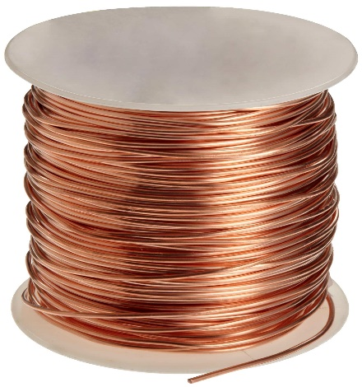
Copper Media
Cables that use copper wires to signal data and control bits between network devices
Eg. twisted pair (UTP / STP), coaxial
Data is transmitted on copper cables as electrical pulses.
Copper media are generally susceptible to attenuation, interference or "noise" (eg. EMI, RFI or Crosstalk)

Slide 27
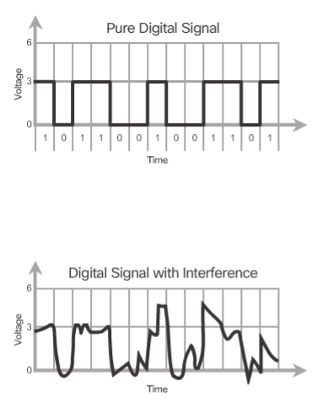

Slide 28
Unshielded Twisted Pair (UTP) cable
Characteristics:
It consists of multiple pairs of color-coded wires that have been twisted together
The twisting has the effect of cancelling unwanted signals and avoid crosstalk.
Terminated with RJ-45 connectors
Advantages:
Common, cheap and easy to install
Disadvantages:
Susceptible to interference (“noise”)
Common application:
Widely used in LAN to connect host, routers and switches

Slide 29
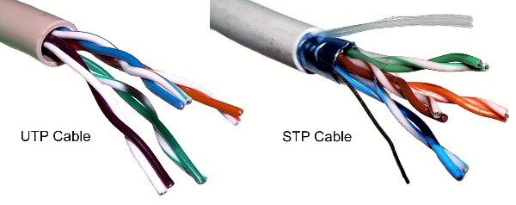
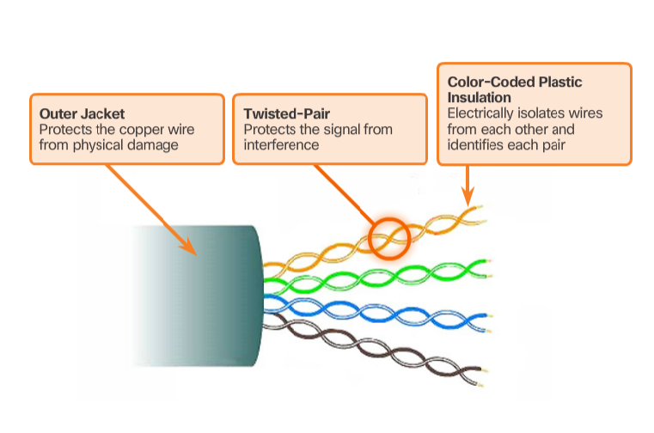
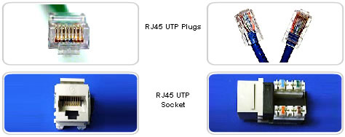
Total 8 pins
Most modern copper based LAN uses CAT-5 (100Mbps Fast Ethernet) UTP

Slide 30
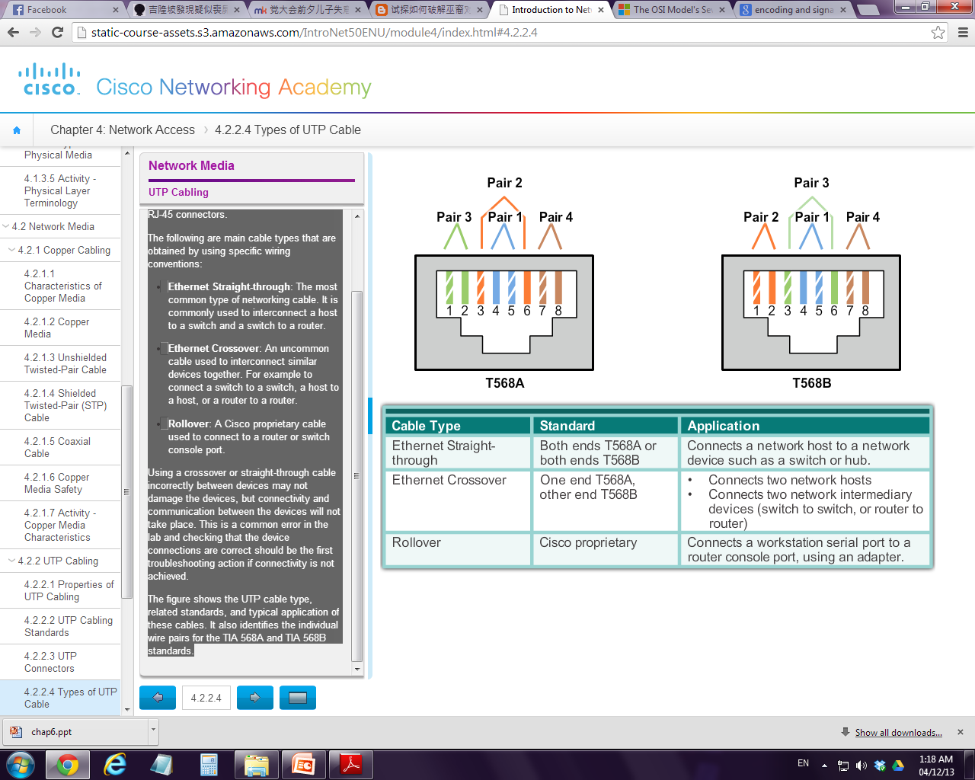
Cont’d…
Different situations may require UTP cables to be wired according to different wiring conventions. (which wires connect to which pins)

Slide 31
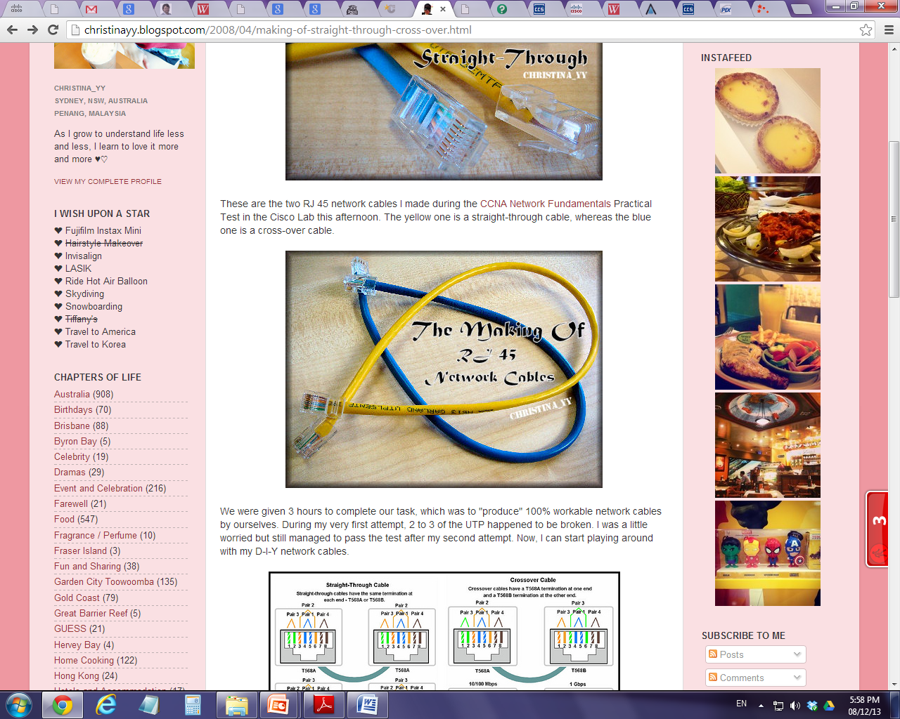
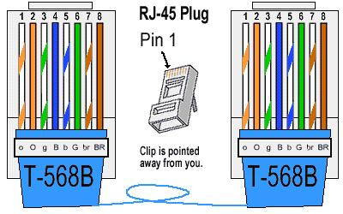
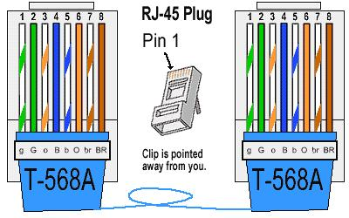
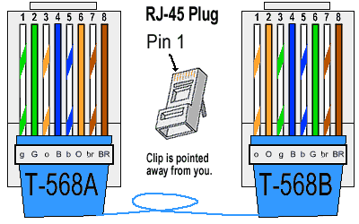
Straight-through cable
Crossover cable

Slide 32
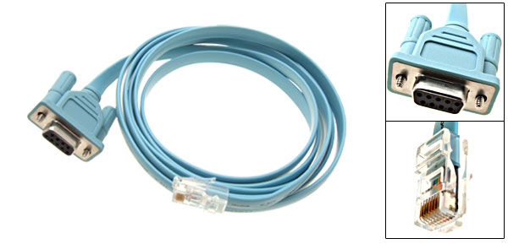
DB-9
RJ-45
Roll0ver cable

Slide 33
Shielded Twisted Pair (STP) cable
Characteristics:
STP uses multiple pairs of twisted wires that are wrapped in an overall metallic braid or foil.
Terminated with RJ-45 connectors
Advantages:
Better noise protection than UTP cabling (counter EMI, RFI and crosstalk)
Disadvantages:
More expensive
Difficult to install
Common application:
Was widely used in Token Ring network

Slide 34
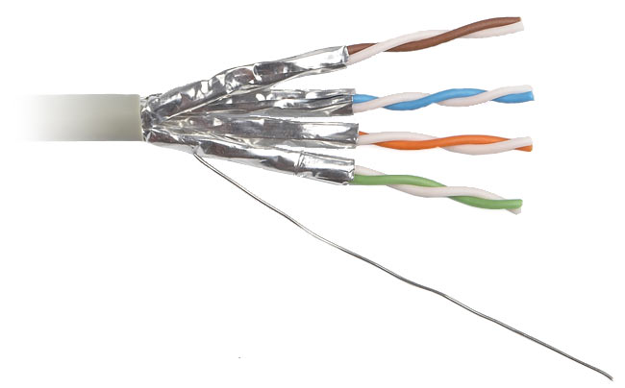
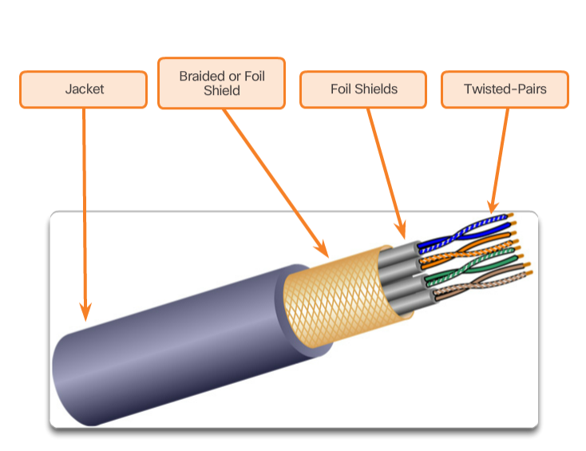
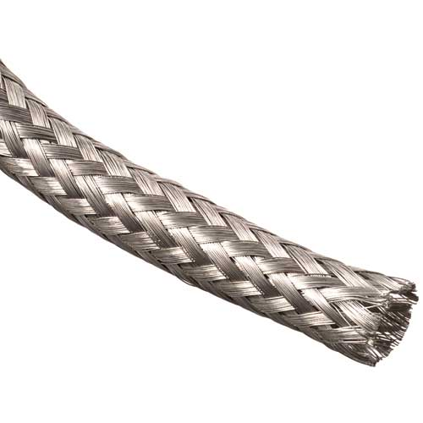
The number of twisted pairs varies depend on the applications.

Slide 35
Coaxial Cable (Coax)
Characteristics:
Consists of a copper conductor surrounded by a layer of insulation and a copper braid / metallic foil, that acts as a shield for the inner conductor.
Advantages:
Good resistance to electrical interference
Can carry more data comparing to UTP and STP
Disadvantages:
Expensive than twisted pair
Common application:
Was traditionally used for cable television and early Ethernet installation
Wireless installations - attach antennas to wireless devices
Cable internet installations - customer premises wiring

Slide 36
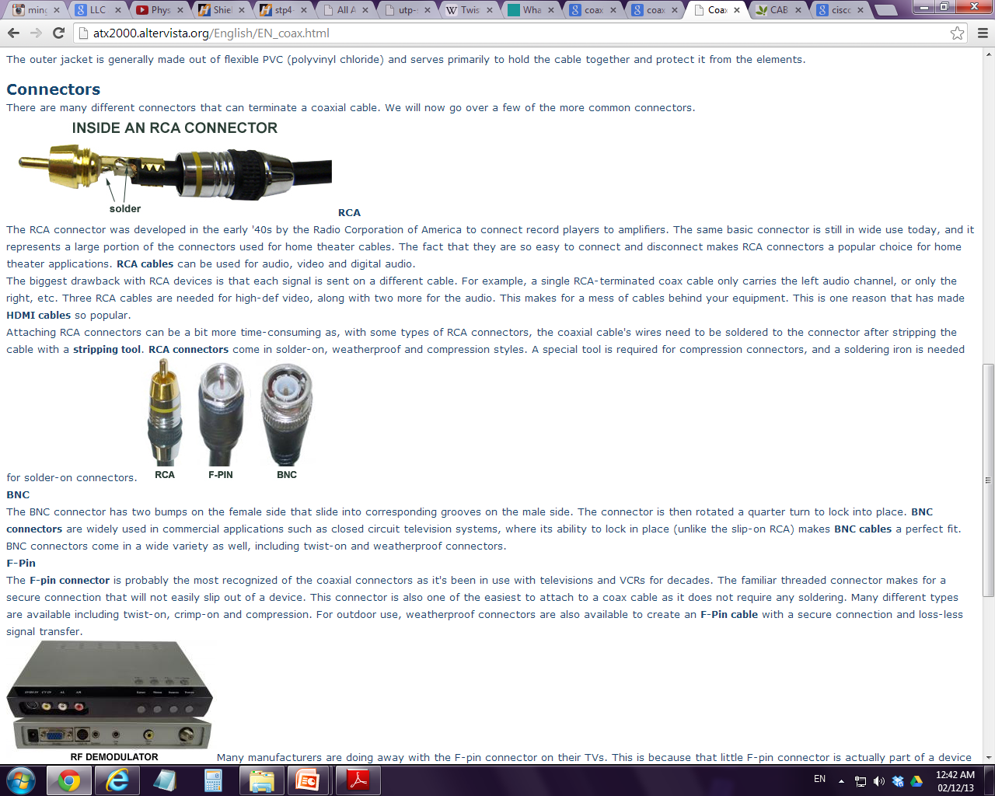
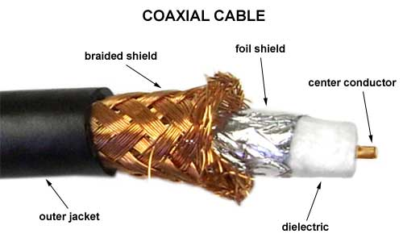
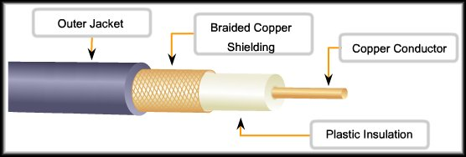
insulator

Slide 37
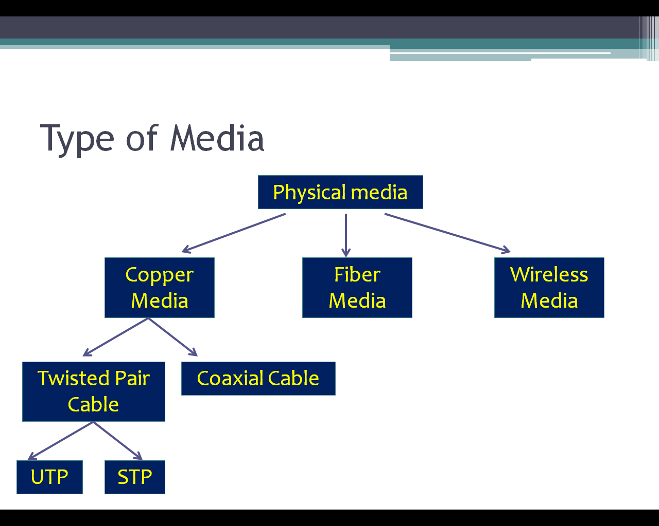
Transmission media

Slide 38
Fiber Media
Characteristics:
Fiber-optic cabling uses either extremely thin glasses or plastic fibers to carry signals from source to destination.
The bits are encoded on the fiber as light impulses .
Advantages:
Much greater bandwidth
Completely Immune to EMI and RFI
Greater transmission distance than copper wire
Disadvantages:
Expensive
Fragile and hard to install
Common application:
Backbone cabling applications and interconnecting infrastructure devices in enterprise or home networks, submarine cable networks, Long-Haul Networks between countries or cities

Slide 39
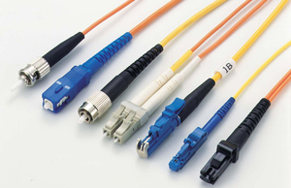
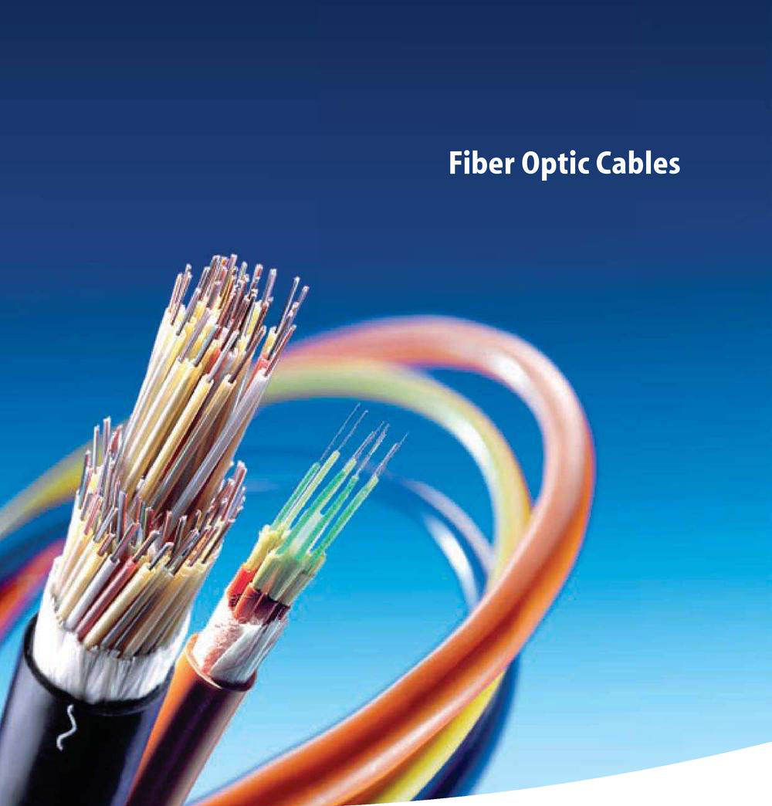
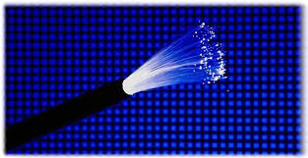
connectors

Slide 40
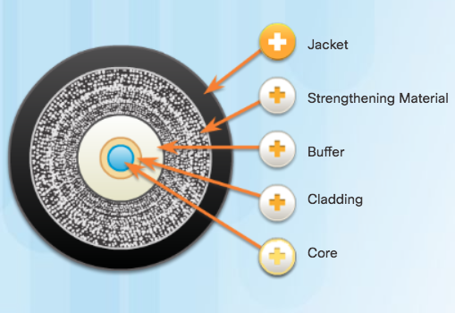

Fiber Media Cable Design
Jacket
Protects the fiber against abrasion, moisture, and other contaminants. Composition can vary depending on the cable usage.
Strengthening Material
Surrounds the buffer, prevents the fiber cable from being stretched when it is being pulled. Often the same material used to produce bulletproof vests.
Buffer
Used to help shield the core and cladding from damage.
Cladding
Tends to act like a mirror by reflecting light back in the core of the fiber. Keeps light in the core as it travels down the fiber.
Core
Light transmission element at the center of the optical fiber. Core is typically silica or glass. Light pulses travel through the fiber core.

Slide 41
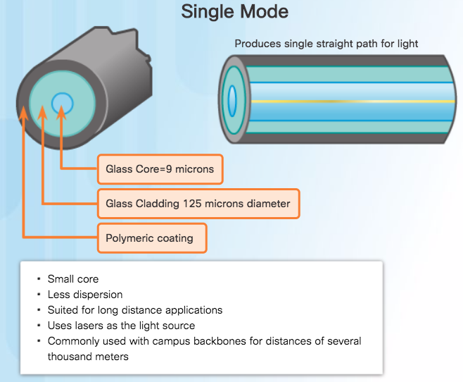
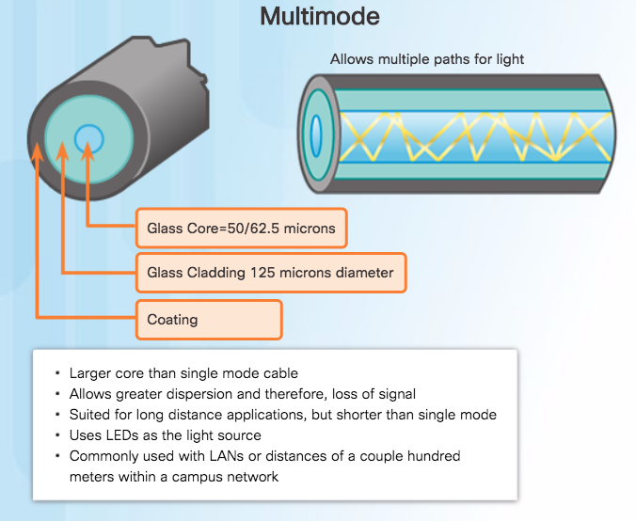
Types of Fiber Media

Slide 42
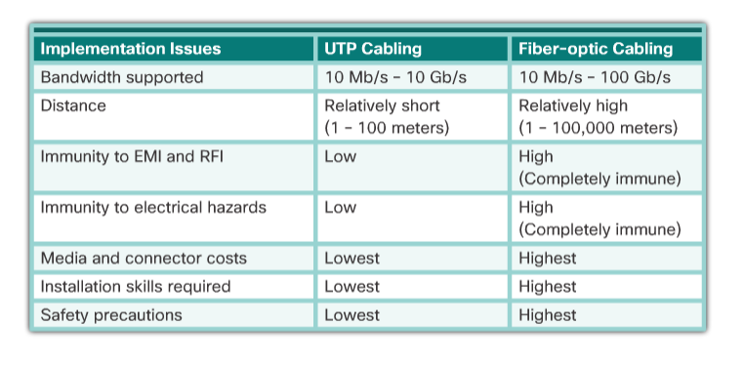

Slide 43
Transmission media

Slide 44
Wireless Media
Characteristics:
Wireless media carry signals at radio and microwave frequencies (wave forms) that represent the binary digits of data communications.
Advantages:
Greater mobility
Ideal for non-reachable places eg. rural areas
Disadvantages:
Lower speed compared to wired network
Less secure
Easily affected by surrounding eg. blocking, interference
Common application:
Radio, cellular phone, wireless network

Slide 45
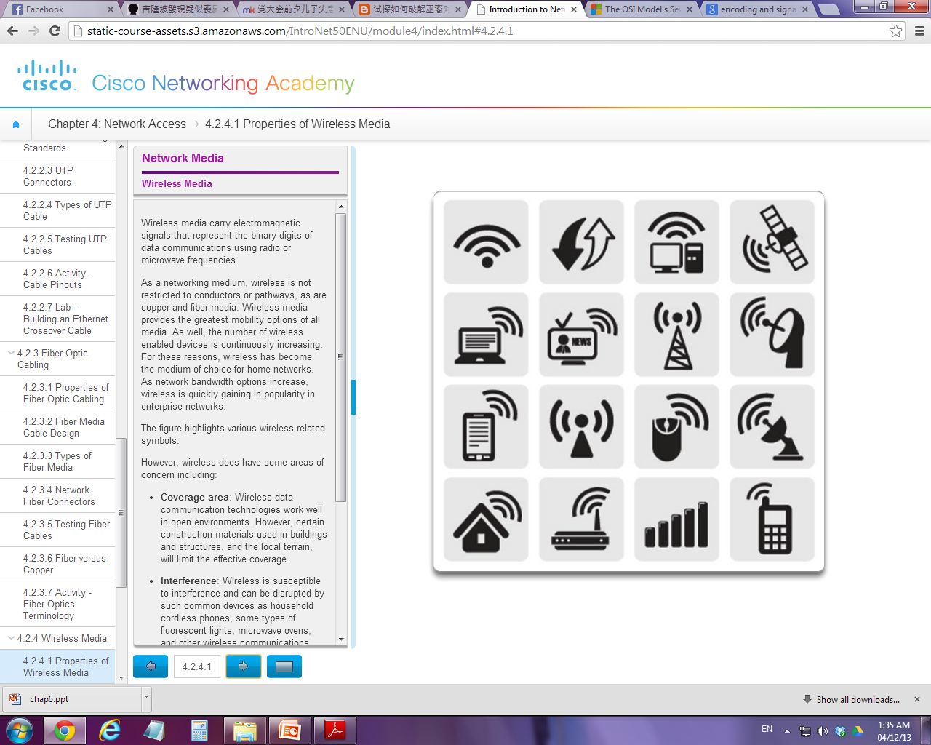

Slide 46
Cont’d…
Four common wireless data communications standards:
IEEE 802.11: Wireless LAN (WLAN) standard → WIFI
IEEE 802.15: Wireless Personal Area Network (WPAN) standard → Bluetooth
IEEE 802.16: Wireless broadband access standard → WIMAX
IEEE 802.15.4 - Low data-rate, low power-consumption communications for Internet of Things (IoT) applications → Zigbee

Slide 47
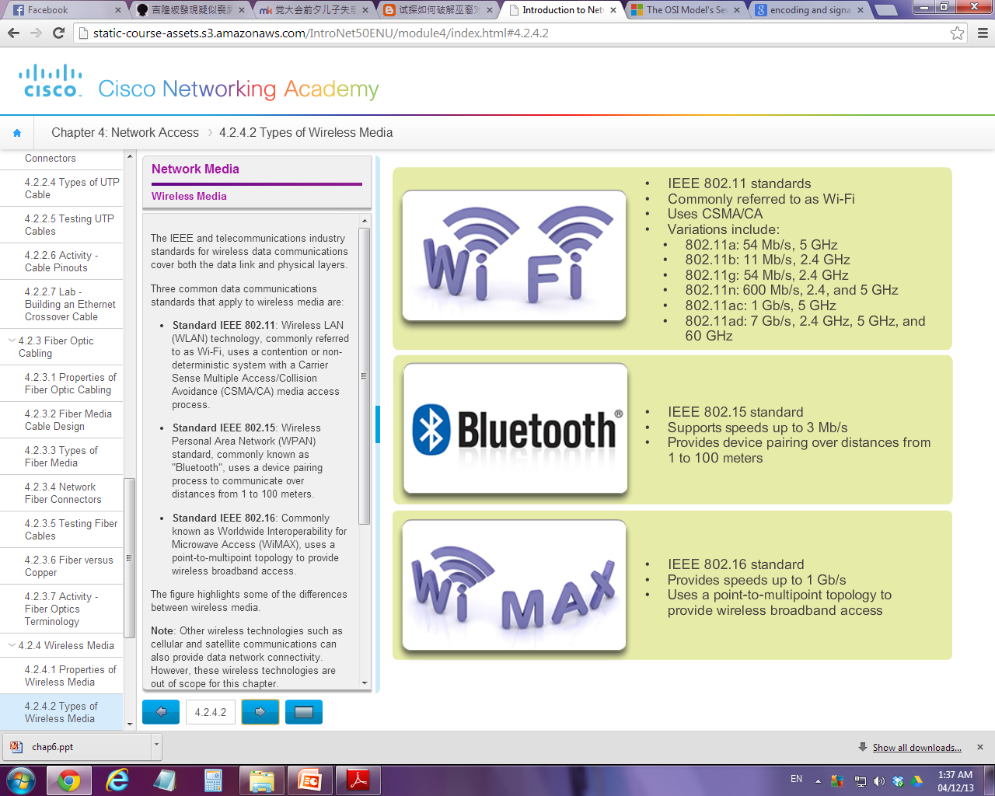
Speed, coverage area, technology

Slide 48
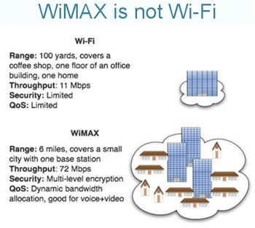

Slide 49
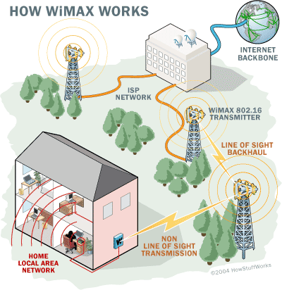

Slide 50
Summary
Roles of Physical Layer
Physical Layer Data Encoding and Signaling
Bandwidth, Throughput and Goodput
Types of transmission media
Characteristics
Advantages / Disadvantages
Common uses

